Slide 1

More on ArrayLists
(based on Ch. 4, Objects First with Java - A Practical Introduction using BlueJ, © David J. Barnes, Michael Kölling)
Produced by:
Dr. Siobhán Drohan
Ms. Mairéad Meagher
Ms Siobhan Roche
Department of Computing and Mathematics
http://www.setu.ie/

Slide 2
Topic list
Grouping Objects
Developing a basic personal notebook project using Collections e.g. ArrayList
Indexing within Collections
Retrieval and removal of objects
Generic classes e.g. ArrayList
Iteration
Using the for loop
Using the while loop
Using the for each loop
Shop – use an ArrayList of Products – more methods

Slide 3
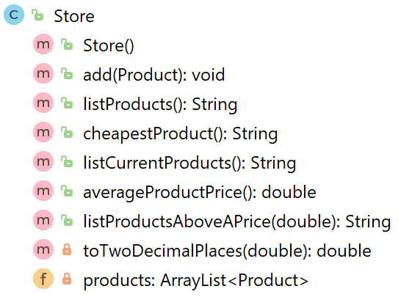
Methods (1)
Store
These methods work on the ArrayList to:
add Products
print out the contents
print out the cheapest product

Slide 4
Add a product object to an ArrayList of Product
Store
The ArrayList holds objects of this type
This is an object variable of type Product that we want to add to the ArrayList.
public void add (Product product)
{
products.add (product);
}

Slide 5
Add a product object to an ArrayList of Product
Store
The ArrayList holds objects of this type
This is an object variable of type Product that we want to add to the ArrayList.
public void add (Product product)
{
products.add (product);
}
The ArrayList of Product
This is the .add() method
from the ArrayList class that we just imported.

Slide 6
Add a product object to an ArrayList of Product
Store
import java.util.ArrayList;
public class Store{
private ArrayList<Product> products;
public Store(){
products = new ArrayList<Product> ();
}
public void add (Product product){
products.add (product);
}
}

Slide 7
Methods (2)
Store
These methods work on the ArrayList to:
add Products
print out the contents
print out the cheapest product

Slide 8
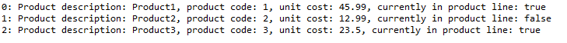
Print out the contents
Store
public String listProducts() { if (products.size() == 0) { return "No products"; } else { String listOfProducts = ""; for (int i = 0; i < products.size(); i++) { listOfProducts += i + ": " + products.get(i) + "\n"; } return listOfProducts; } }
Sample Output

Slide 9
Print out the contents
Store
If the size of the products ArrayList is zero,
return the String “No products” to the Driver class to be printed.
public String listProducts() { if (products.size() == 0) { return "No products"; } else { String listOfProducts = ""; for (int i = 0; i < products.size(); i++) { listOfProducts += i + ": " + products.get(i) + "\n"; } return listOfProducts; } }
Sample Output

Slide 10
Print out the contents
Store
public String listProducts() { if (products.size() == 0) { return "No products"; } else { String listOfProducts = ""; for (int i = 0; i < products.size(); i++) { listOfProducts += i + ": " + products.get(i) + "\n"; } return listOfProducts; } }
If there are products in the ArrayList…
return a String containing the index number of each product & the product details.
Sample Output

Slide 11
Methods (3)
Store
These methods work on the ArrayList to:
add Products
print out the contents
print out the cheapest product

Slide 12
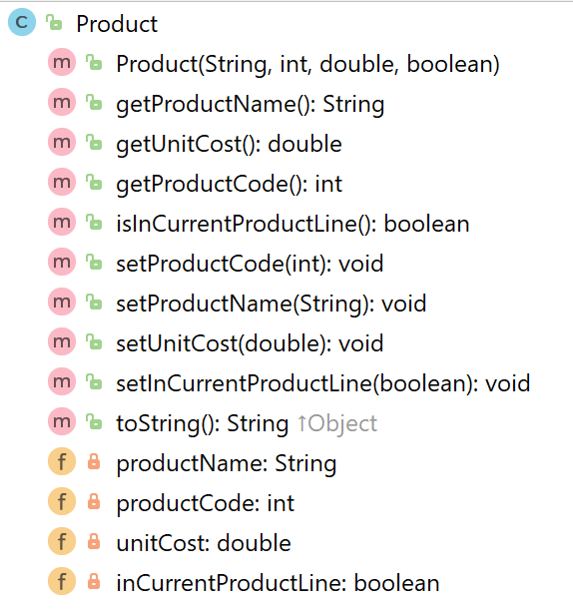
Finding the Cheapest Product
Product
getter
private field – unit cost

Slide 13
Finding the Cheapest Product Algorithm (numbered steps)
Store
If products have been added to the ArrayList
1.1 Assume that the first Product in the ArrayList is the cheapest (set a local variable to store this object).
1.2 For all product objects in the ArrayList
1.2.1 if the current product cost is lower than the cost of
the product object stored in the local variable,
1.2.1.1 update the local variable to hold the current product object.
end if
end for
1.3 Return the name of the cheapest product.
else
1.4 Return a message indicating that no products exist.
end if

Slide 14

Finding the Cheapest Product (step 1.)
Store
Working on the outer if statement (step 1.)
if products have been added to the ArrayList
return the cheapest product
else
return a message indicating that no products exist.
end if
Q: How do we write the code for this algorithm?

Slide 15

Store
if (products.size() != 0){
//return the cheapest product
}
else{
return “No products are in the ArrayList”;
}

Slide 16
Store
Another valid approach!
if (!products.isEmpty()){
//return the cheapest product
}
else{
return “No products are in the ArrayList”;
}

Slide 17
Working on step 1.1
Store
if products have been added to the ArrayList
// 1.1 Assume that the first Product in the ArrayList is the cheapest // (set a local variable to store this object).
else
return a message indicating that no products exist.
end if
Q: How do we write the code for this step?

Slide 18
step 1.1
Store
if (products.size() != 0){
Product cheapestProduct = products.get(0);
}
else{
return “No products are in the ArrayList”;
}

Slide 19
Working on the for loop step 1.2
Store
if products have been added to the ArrayList
// 1.1 Assume that the first Product in the ArrayList is the cheapest // (set a local variable to store this object).
// 1.2 For all product objects in the ArrayList
// determine the cheapest product
// end for
else
return a message indicating that no products exist.
end if
Q: How do we write the code for this step?

Slide 20
step 1.2
Store
if (products.size() > 0){
Product cheapestProduct = products.get(0);
for (Product product : products)
{
}
}
else{
return “No products are in the ArrayList”;
}

Slide 21
for each loop
Store
if (products.size() > 0){
Product cheapestProduct = products.get(0);
for (Product product : products)
{
}
}
else{
return “No products are in the ArrayList”;
}
Product: This is the type of object that is stored in the ArrayList.
product: This is the reference to the current object we are looking at in the ArrayList. As we iterate over each object in the ArrayList, this reference will change to point to the next object, and so on.
products: This is the ArrayList of Product.

Slide 22
step 1.2.1
Store
If products have been added to the ArrayList
1.1 Assume that the first Product in the ArrayList is the cheapest (set a local variable to store this object).
1.2 For all product objects in the ArrayList
1.2.1 if the current product cost is lower than the cost of
the product object stored in the local variable,
1.2.1.1 update the local variable to hold the current product object.
end if
end for
1.3 Return the name of the cheapest product.
else
1.4 Return a message indicating that no products exist.
end if
Q: How do we write the code for this step?

Slide 23
step 1.2.1
Store
if (products.size() > 0){
Product cheapestProduct = products.get(0);
for (Product product : products){
if (product.getUnitCost() < cheapestProduct.getUnitCost())
{
}
}
}
else
{
return “No products are in the ArrayList”;
}

Slide 24
Step 1.2.1.1
Store
If products have been added to the ArrayList
1.1 Assume that the first Product in the ArrayList is the cheapest (set a local variable to store this object).
1.2 For all product objects in the ArrayList
1.2.1 if the current product cost is lower than the cost of
the product object stored in the local variable,
1.2.1.1 update the local variable to hold the current product object.
end if
end for
1.3 Return the name of the cheapest product.
else
1.4 Return a message indicating that no products exist.
end if
Q: How do we write the code for this step?

Slide 25
Step 1.2.1.1
Store
if (products.size() > 0){
Product cheapestProduct = products.get(0);
for (Product product : products){
if (product.getUnitCost() < cheapestProduct.getUnitCost()){
cheapestProduct = product;
}
}
}
else{
return “No products are in the ArrayList”;
}

Slide 26
Working on the last step, 1.3
Store
If products have been added to the ArrayList
1.1 Assume that the first Product in the ArrayList is the cheapest (set a local variable to store this object).
1.2 For all product objects in the ArrayList
1.2.1 if the current product cost is lower than the cost of
the product object stored in the local variable,
1.2.1.1 update the local variable to hold the current product object.
end if
end for
1.3 Return the name of the cheapest product.
else
1.4 Return a message indicating that no products exist.
end if
Q: How do we write the code for this step?

Slide 27
step, 1.3
Store
if (products.size() > 0){
Product cheapestProduct = products.get(0);
for (Product product : products){
if (product.getUnitCost() < cheapestProduct.getUnitCost()){
cheapestProduct = product;
}
}
return cheapestProduct.getProductName();
}
else{
return “No products are in the ArrayList”;
}

Slide 28
Methods
Store
We have look at the following methods:
add Products
print out the contents
print out the cheapest product
There are other methods in Store that operate on the ArrayList. They have a similar approach to the methods above; we can look at these in labs if you wish.

Slide 29
driver
Refactor this class to handle a small change to the Store “interface”.

Slide 30
Store
Constructor
This was the only change to the public interface; we removed the parameter!

Slide 31
Previously our Shop used an array and we needed to know
how many Products to store:
Driver
store = new Store(numberProducts);
Now that we are using an ArrayList, we don’t need to set a capacity, so our constructor call becomes:
store = new Store();

Slide 32
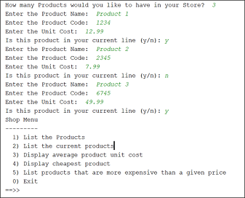
Our output when we run V3.0 of the app:
Driver

Slide 33
V3.0 output:
No difference in output…we only changed the internal storage mechanism!
V2.2 output:

Slide 34
Collections
Allow an arbitrary number of objects to be stored.
Are implemented in Java’s Class libraries which contain tried-and-tested collection classes.
In Java’s class libraries are called packages.
We have used the ArrayList class from the java.util package.

Slide 35
ArrayList
Items may be added and removed.
Each item has an index.
Index values may change if items are removed (or further items added).
The main ArrayList methods are:
add()
get()
remove()
size()
ArrayList is a parameterized or generic type.

Slide 36

Questions?

